Slide 1
Comprehensive Digital Marketing
Project Work

Slide 2
Team ID : LTVIP2023TMID03871
Team Size : 5
Team Leader : CHUNDURI TANISH
Team member : AKANKSHA
Team member : jonan suphal.S
Team member : POLAVARAPU VENKATASIVASAI
Team member : Mutnuru.Sai Sri Charan

Slide 3
Students will be divided into 50 groups each having an individual brand name and within this would be 9 students each
Lakmé
Allen Solly
Apollo Hospitals
VLCC
Fortis healthcare institute
Fabindia
Forest Essentials
Flying Machine
Himalaya Herbals
Bata
John Players
Khadi Naturals
Louis Philippe
Liberty
Juicy Chemistry
Paragon
Peter England
Biotique
Red Tape
Britannia
Mother Dairy
Tech Mahindra
Axis Bank
Amul
Wipro
Parle Agro
Tech Mahindra
McCain
ICICI Bank
Kissan
MTR Foods
Sunfeast
HDFC Bank
HRX
Yes Bank
Cadbury
Haldiram’s
Balaji Telefilms
Digit Insurance
Life Insurance Corporation Of India
Bajaj Electricals
Havells India Ltd.
Videocon Industries Limited
Crompton Greaves Consumer Electricals
Tata Motors
Maruti Suzuki India Ltd
Mahindra & Mahindra Ltd
Hero MotoCorp Ltd
Ashok Leyland Ltd
Apollo Tyres

Slide 4
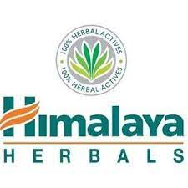
Part 1: Brand study, Competitor Analysis & Buyer’s/Audience’s Persona
COMPANY/TOPIC for the project: HIMALAYA HERBALS.
Brand Study
Himalaya Herbals is a well-known Indian company that has established itself as a leading player in the herbal healthcare and personal care industry. Founded in 1930 by M. Manal, the company's roots can be traced back to a small pharmaceutical operation in Dehradun, India. Over the years, Himalaya Herbals has grown to become a trusted global brand, renowned for its commitment to natural and Ayurvedic principles in product development.
Brand colours: green, orange and white.
Logo:

Slide 5
Mission/Values:
Bring wellness and joy to every home via herbal solutions based on science.
Establish Himalaya as a science-based, problem-solving, head-to-heel brand, harnessed from nature's wealth and characterized by trust and healthy lives.
Develop markets worldwide with an in-depth and long-term approach, maintaining at each step the highest ethical standards.
Respect, collaborate with, and utilize the talents of each member of the Himalaya family and the local communities, to drive our seed-to-shelf policy and to rigorously adopt eco-friendly practices to support the environment we inhabit.
USP: The USP of HIMALAYA HERBAL CARE is adding ayurvedic ingredients in most of their product.
Tagline: “Wellness in Every Home, Happiness in Every Heart”.

Slide 6
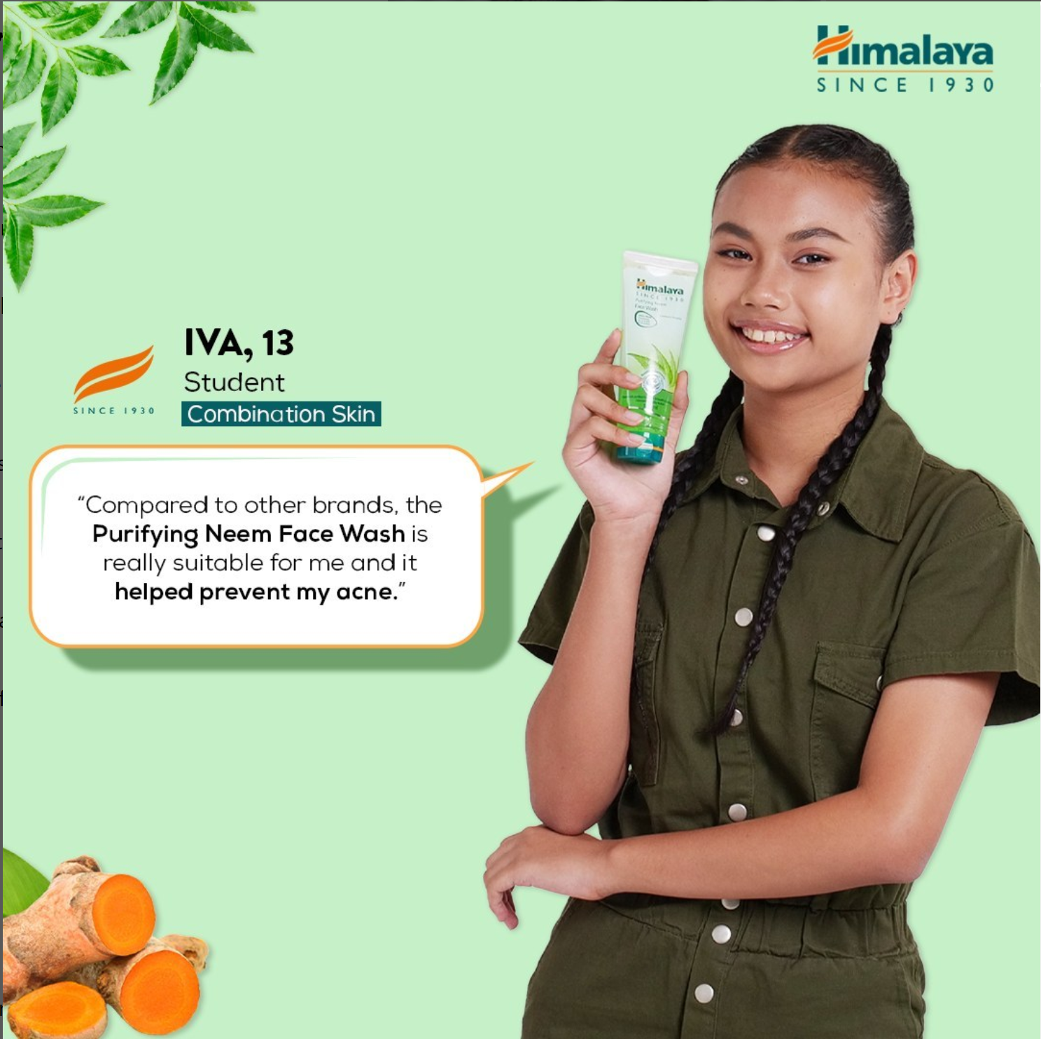
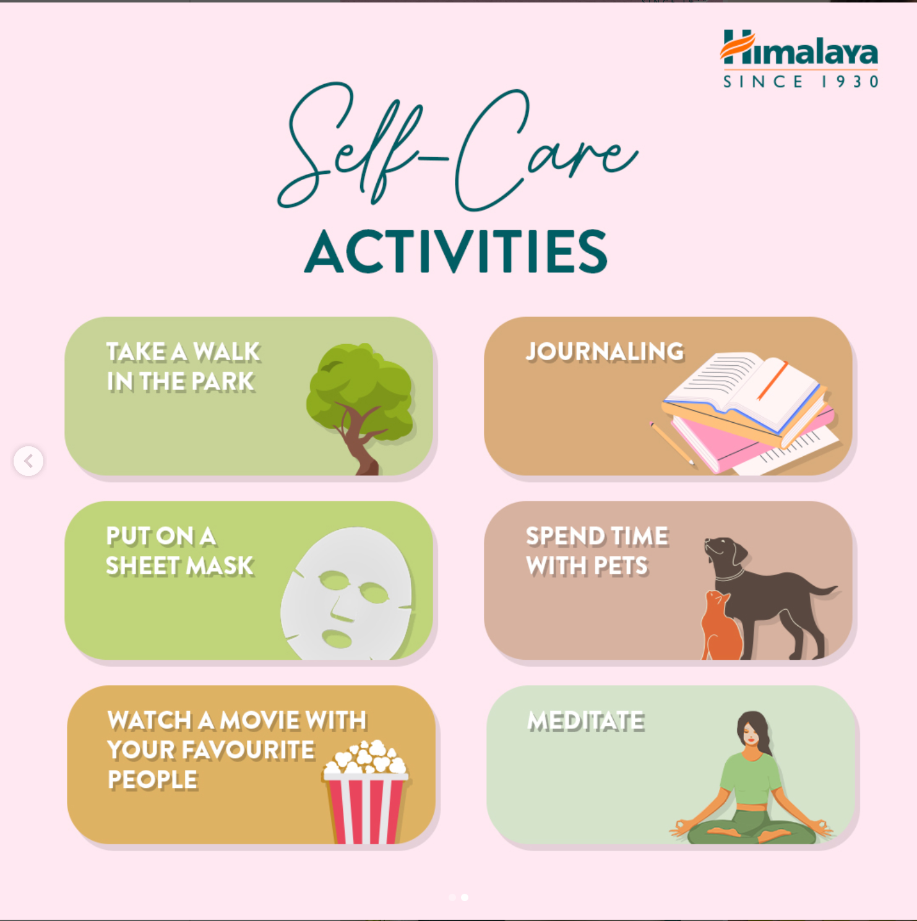

Brand Messaging:
Formal, fun and highly informative.
Consumer friendly – uses real consumer reviews and feedbacks so as to promote the product as well as make any improvements if need be.
Guides consumers to select the right product for their requirements.
Provides health and self care awareness.
https://www.instagram.com/p/CtbSlO8trXL/
https://www.instagram.com/reel/CuY0mRetVA6/?utm_source=ig_web_copy_link&igshid=MzRlODBiNWFlZA==
https://www.instagram.com/p/CsyF3SVM_9k/

Slide 7
Part 1: Brand study, Competitor Analysis & Buyer’s/Audience’s Persona
Competitor Analysis: Select three competitors operating in the same industry or niche as the chosen brand, examine their USPs and online communication.
Competitor 1: BIOTIQUE.
USP: Biotique has been positioned as a market leader in the wellness sector with the USP of the brand being ayurvedic products that are made from 100 percent naturally sourced ingredients.
Tagline: Indulge in the goodness of non-toxic beauty.
Online communication:
Creative, entertaining and highly engaging.
Hires celebrities as brand ambassdors so as to attract a wide range of audience towards the brand.Eg: Actress Sara Ali Khan is the current brand ambassador of biotique.
Highly engaging – uses famous female characters from Bollywood movies and showcases how and which biotique products those characters would use.
Competitor 2: DABUR INDIA LIMITED.
USP: Dabur is the world's largest Ayurvedic and natural health care company based out of India
Tagline: Celebrate Life

Slide 8
Online communication:
Completely formal and informative.
Conducts many welfare activities in healthcare, education etc. thereby building a very strong and trustworthy brand image.
Creates health awareness among consumers and informs how their products can help alleviate their health concern through social media and television adverstisements.
Competitor 3: PATANJALI AYURVED LIMITED.
USP: Patanjali sells only Ayurveda based products in food, cosmetics and FMCG.
Tagline: ‘Prakriti ka aashirwaad’
Online communication:
Formal, Easy to understand and instructive.
Uses a strong brand ambassador Baba Ramdev to help boost the brand image of patanjali at a very rapid rate.
“Word of mouth” has been a very significant promotional tool for this brand’s success.
Uses elements of yoga and spirituality to showcase the uses and need for the product.

Slide 9
Buyer's/Audience's Persona: Clearly define the target audience for the chosen brand. Consider demographics, psychographics, behaviors, and interests.
DEMOGRAPHICS:
Age: 15 - 70 yrs old. This age group typically includes individuals who are more concerned about their skincare, health, and well-being and are willing to invest in herbal and natural products.
Gender: Himalaya Herbals products are designed for both men and women.
Children: yes/no
Marital status: married/unmarried.
Location: over 100 countries.
Income: 4,00,000 per annum – 30,00,000 per annum.
Education: atleast 10th standard.
PSYCHOGRAPHICS:
Personality: Conscientiousness, self-motivated and resilient.
Lifestyle: active lifestyle, engaging in regular exercise and overall physical wellbeing.
Values: health and wellbeing, mindfulness, self-care and self-improvement.
Attitudes: positive health outlook, prevention oriented, trust in natural and herbal remedies.
Beliefs: personal responsibility, preventive care and holistic wellness.
Interests: fitness, mindfulness, skincare and beauty and stress management.

Slide 10
Part 2: SEO & Keyword Research
SEO Audit: Do an SEO audit of the brands website
Keyword Research: Define Research Objectives, Brainstorm Seed Keywords, Utilize Keyword Research Tools (SEMrush or Moz Keyword Explorer),Analyze Competitor Keywords, Long-tail Keyword Exploration (specific, longer phrases) that align with the research objectives and have lower competition but higher conversion potential.
On page Optimization: Meta Tag optimization & content optimization
Reflect on the process of conducting keyword research and the SEO recommendations provided.
Document the challenges faced during the research and analysis phase, as well as the key insights gained from the keyword research process.

Slide 11
SEO Audit
An SEO audit is the process of evaluating how well your website is optimized for search engines. It identifies errors that can prevent your site from ranking well and opportunities that can help you rank better. An SEO audit usually covers areas like: Indexing and crawlability.
An SEO audit is the process of analyzing how well your web presence relates to best practices – it is the first step to creating an implementation plan that will have measurable results. The purpose of the audit is to identify as many foundational issues affecting organic search performance as possible.

Slide 12
Objectives of Keyword Research.
Some common research objectives for Himalaya herbal products included:
1.Identification of bioactive compounds: Researchers aim to identify the active chemical constituents in herbal products responsible for their therapeutic effects. This involves isolating and characterizing various compounds to bet ter understand their mechanisms of action.
2.Formulation and dosage optimization: Researchers strive to optimize the formulation and dosage of herbal products to maximize their efficacy while minimizing potential adverse effects. This involves exploring different delivery methods and dosage regimens.
3.Interaction with conventional medicine: Understanding potential interactions between herbal products and conventional drugs is vital to ensure patient safety. Researchers investigate how herbal remedies may interact with prescription medications and influence their efficacy or side effects.
4.Treatment of specific conditions: Research may focus on exploring the potential of herbal products in treating specific diseases or health conditions, such as diabetes, cardiovascular disorders, respiratory issues, and more.
5.Health promotion and disease prevention: Research may explore the use of herbal products for health promotion and disease prevention, focusing on improving overall well-being and reducing the risk of chronic illnesses.
In summary, the research objectives of himalaya herbal products encompass a broad spectrum of scientific investigations to bet ter understand their efficacy, safety, mechanisms of action, and potential applications in healthcare.

Slide 13
Brainstorm Seed Keywords.
Here's a brainstorm of seed keywords related to himalaya herbal products:
Herbal remedies
Medicinal plants
Natural supplements
Herbal medicine
Traditional medicine
Herbal extracts
Herbal teas
Herbal formulations
Herbal supplements
Herbal remedies for [specific condition]
Herbal remedies for [specific symptom]
Herbal treatments
Herbal product standardization
Herbal products and diabetes
These seed keywords can serve as a starting point for conducting research or generating content related to Himalaya herbal products and their various aspects.

Slide 14
Keyword Research.
Keyword research is the process of finding and analyzing search terms that people enter into search engines with the goal of using that data for a specific purpose, often for search engine optimization (SEO) or general marketing.
KEYWORD RESEARCH FOR HIMALAYA HERBALS
The following are the relevant keywords of Himalaya Herbals brand that have been found after thorough research and filtering.These keywords are further filtered as per the high and low traffic, popularity, and few other criteria based on the requirement of ourresearch.
1. KEYWORD: NEEM FACEWASH

Slide 15
2. KEYWORD: HERBAL FACEWASH

Slide 16
Competitor’s Keyword Research.
1. BIOTIQUE.
A combination of the 5,000-year-old science of Ayurveda and 21st-century biotechnology. A dream that has today become a global reality. We are synonymous with serious skin and hair care developed from Ayurveda, the principal medical tradition in India for over 5000 years. Longer than long ago, health and beauty were fleeting. The average adult life expectancy was 30 years old, as nature took its toll. Then, 5000 years ago, Aryan sages in India searched within the vast resources of nature to extend this ephemeral existence.This is where Vinita Jain, our founder, grew up.And where our story begins…

Slide 17
2. Dabur India Limited
Dabur Ltd is an Indian multinational consumer goods company, founded by S. K. Burman and headquartered in Ghaziabad.It manufactures Ayurvedic medicine and natural consumer products, and is one of the largest fast-moving and is one of the largest fast-moving consumer goods (FMCG) companies in India. Dabur derives around 60% of its revenue from the consumer care business, 11% from the food business and remaining from the international business unit.

Slide 18
3. Patanjali Ayurved.
Patanjali Ayurved is an Indian multinational conglomerate holding company,based in Haridwar, India.It was founded by Ramdev and Balkrishna in 2006.Its office is in Delhi,with manufacturing units and headquarters in the industrial area of Haridwar.The company manufactures cosmetics, ayurvedic medicine,personal care and food products.The CEO of the company,with a 94-percent share hold,is Balkrishna. Ramdev represents the company and makes strategic decisions.

Slide 19
Long-Tail Keyword Research.
Long-tail keywords are longer and more specific keyword phrases that visitors are more likely to use when they're closer to a point-of-purchase or when they're using voice search. Most long-tail keywords have lower search volume than short or “head” keywords. Long-tail keywords tend to be at least three words long due to their specificity, but precise low-volume searches that are only one or two words long (such as many brand names) are also considered long-tail keywords. Long-tail keywords are highly specific search queries that tend to have relatively low search volumes. Although users search for them less of ten, long-tail keywords make up a large percentage of overall searches when added together.

Slide 20
Meta Tag Optimisation
Meta Tag | Meta Tag Description
Himalaya Herbals | Natural Herbal Products for Skincare & Wellness. | "Discover the natural goodness of Himalaya Herbals products. Our herbal remedies promote wellness and skincare using time-tested Ayurvedic principles. Explore our range of herbal solutions for a healthier, radiant you."

Slide 21
Process of Conducting Keyword Research.
Keyword research is a crucial step in search engine optimization (SEO) and content marketing strategies. It helps you identify the most relevant and valuable keywords that your target audience is using to search for information related to herbal products. Here's a step-by-step process for keyword research:
1. Understand Your Target Audience: Begin by defining your target audience for herbal products. Consider demographics, interests, and pain points. Understanding your audience will help you tailor your keyword research to their needs and preferences.
2. Brainstorm Seed Keywords: As we did earlier, start by brainstorming seed keywords. These are general terms related to herbal products, like "herbal remedies," "medicinal plants," or "herbal medicine." Use your knowledge of the herbal products niche to come up with a comprehensive list of seed keywords.
3. Keyword Research Tools: Utilize keyword research tools to expand your list and find related keywords. Tools like Google Keyword Planner,Ahrefs, SEMrush, and Ubersuggest can provide valuable insights into keyword search volume, competition, and related terms.
4. Long-Tail Keywords: Long-tail keywords are longer and more specific phrases that users of ten use when searching. They may have lower search volume but can be highly targeted. For example, "herbal remedies for insomnia" or "best herbal supplements for joint pain."Include relevant long-tail keywords in your research.

Slide 22
5. Seasonal and Trending Keywords: Stay updated with seasonal and trending keywords related to herbal products. Some topics may gain popularity during specific times of the year or due to current events.
6. Keyword Difficulty and Opportunity: Assess the keyword difficulty and opportunity. Some keywords may have high competition, making it challenging to rank for them. Balancing competitive keywords with less competitive ones can help optimize your SEO strategy.
7. Organize and Prioritize Keywords: Categorize your keywords based on relevance and search volume. Prioritize the most relevant and valuable keywords for your content creation and marketing efforts.
8. Create Quality Content: Develop high-quality, informative, and engaging content around your targeted keywords. Address the search intent and provide value to your audience. This will improve your chances of ranking higher in search engine results.
9. Monitor and Adjust: Regularly monitor the performance of your content and keywords. Analyze website traffic and search rankings to identify what works well and make adjustments as needed.
Keyword research is an ongoing process, and it's essential to keep refining your strategy based on changes in search trends and your target audience's preferences. By effectively researching and incorporating relevant keywords, you can enhance your online visibility and attract more organic
traffic to our Himalaya herbals products website.

Slide 23
SEO Recommendations Provided
Implementing effective Search Engine Optimization (SEO) strategies can significantly improve online visibility, increase organic traffic, and at tract potential customers. Here are some SEO recommendations tailored specifically for himalaya herbal product website:
1. Keyword Research: Conduct comprehensive keyword research to identify relevant and high-traffic keywords related to herbal products.Focus on both general seed keywords and specific long-tail keywords to target a wide range of potential customers.
2. Optimize On-Page Elements: Ensure that your website's on-page elements are well-optimized for SEO. This includes optimizing title tags, meta descriptions, heading tags (H1, H2, H3), and U RL structures with targeted keywords to improve search engine rankings.
3. High-Quality Content: Create high-quality, informative, and valuable content related to herbal products. Develop blog posts, articles, product descriptions, and guides that address the needs and interests of your target audience. Use keywords naturally within the content.
4. Product Pages Optimization: Optimize individual product pages with unique and compelling product descriptions. Incorporate relevant keywords and provide detailed information about the benefits, usage, and ingredients of each herbal product.
5.Mobile-Friendly Website: Ensure your website is mobile-friendly and responsive. With the increasing use of mobile devices, having a mobile-friendly site is crucial for better user experience and search engine rankings.

Slide 24
Challenges Faced During the Research And Analysis Phase
Here are some common challenges faced during the keyword research and analysis phase for Himalaya herbal products:
1.Limited Search Volume: Some herbal products or specific long-tail keywords may have low search volume, making it challenging to identify high-traffic keywords to target. This limits the potential organic traffic that can be generated from these keywords.
2.High Competition: The herbal products market can be competitive, with many companies vying for visibility in search engine results. Ranking for popular keywords may be difficult due to strong competition from well-established brands.
3.Seasonal Variations: The demand for certain herbal products may vary seasonally, and this can influence keyword trends. Keyword research needs to consider these seasonal variations to optimize content accordingly.
4.Shifting Trends and Terminology: The language and terminology used in the herbal products industry can change over time. Keeping up with shifting trends and incorporating updated keywords is necessary for maintaining relevance.
5.Balancing Traditional and Modern Terms: Herbal products may have both traditional and modern names, and keyword research should consider both to capture a broader audience.
Overcoming these challenges involves a combination of creativity, thorough research, and adaptability.

Slide 25
Key Insights Gained From Keyword Research Process
Here are some key insights that we gained from the keyword research process:
1. Search Demand and Interest: Keyword research provides an understanding of the search demand and interest in specific herbal products. It reveals which products or herbal remedies are most sought after by users and can help prioritize content and marketing efforts accordingly.
2. Target Audience Behavior: Keyword research sheds light on how the target audience searches for herbal products. It helps in identifying the language and phrases used by potential customers, enabling businesses to better communicate with their audience.
3. Seasonal Trends: Analyzing keyword trends over time can unveil seasonal variations in demand for herbal products. This insight can be leveraged to create timely content or promotional campaigns to capitalize on peak demand periods.
4. Long-Tail Keyword Insights: Long-tail keywords of ten have lower search volume but are highly specific and targeted. Keyword research helps identify long-tail keyword opportunities that can at tract more qualified leads and potential customers interested in specific herbal solutions.
5. Competitor Analysis: Keyword research can reveal the keywords that competitors are targeting. Analyzing competitor strategies helps businesses understand their competitive landscape and find ways to differentiate their offerings.
6. User Pain Points: Keywords related to specific health conditions or concerns can reveal users' pain points. This insight helps businesses tailor their messaging and product offerings to address these pain points effectively.

Slide 26
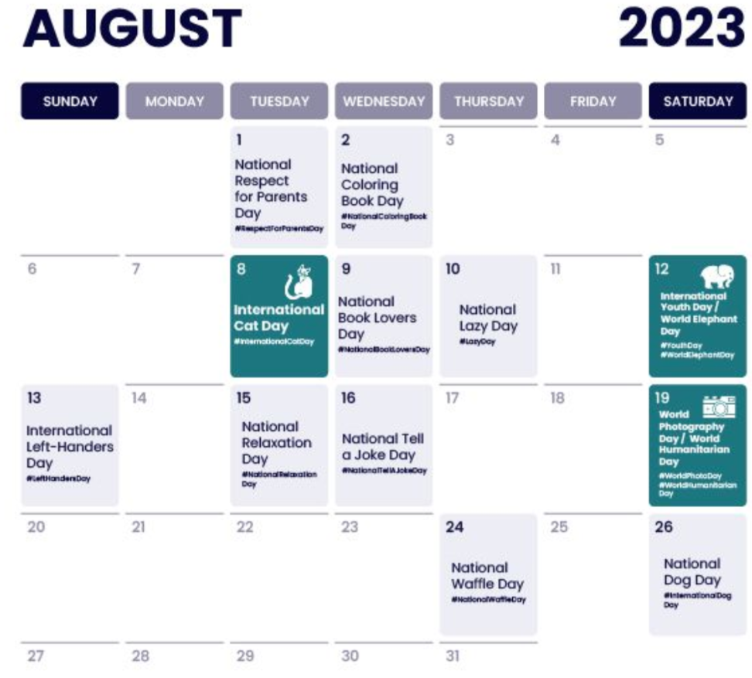
Part 3: Content Ideas and Marketing Strategies
Post
Reels.
Send
Emails.
Content Idea Generation & Strategy: Create a content calendar for the remaining month of July by brainstorming content themes, exploring various formats like blog posts, videos, infographics, podcasts, and interactive quizzes, and scheduling publication dates mainly on Facebook & Instagram. And include the strategy, aim and the idea behind these posts and story
Content Calendar Example (Try creating a table for the month of august)
Post a video
Post a blog
Run an health awareness
campaign
Post a youtube video
Facebook post
IG live about the brand
Put out a tweet.
Upload tiktoks
Instagramgiveaway contest
Facebook live

Slide 27
Part 3: Content Ideas and Marketing Strategies
Reflect on the content ideas and marketing strategies process, discussing the challenges encountered and lessons learned.
Content ideas and marketing strategies process:
The process of getting content ideas and marketing strategies has been relatively challenging and creative. We researched about the brand, their tagine, their USP etc to understand what exactly it is that the brand is providing to its consumers. After we understood our brand, finding our target audience was easy. After some research we developed content and marketing strategies that would actually get some response and engagement from the audience. We developed social media content and ran email ad campaigns and also we had run seo keyword research.
Challenges encountered:
Understanding the brand and target audience.
Creating engaging and informative content.
Promoting a balanced message.
Building an engaging community.
Lessons learnt:
Investing time in understanding the brand and target audience at the initial stage can make the rest of the process effective.
Offering valuable tips and insights without making health claims can enhance audience trust.
Providing evidence-based information to support product claims can enhance credibility.
Engaging with the audience through social media, email newsletters, and interactive content can foster a loyal community. Responding to feedback and addressing customer concerns promptly can build trust.

Slide 28
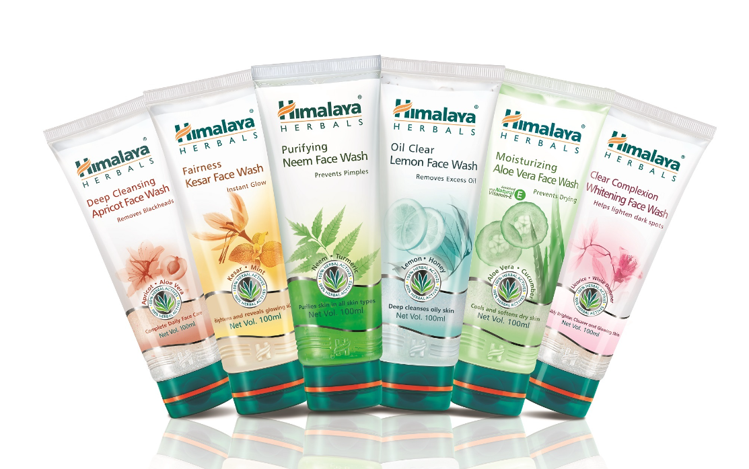
Part 4: Content Creation and Curation (Post creations, Designs/Video Editing, Ad Campaigns over Social Media and Email Ideation and Creation)
Post Creation:
Format 1: Blog article
Aim: Boost seo & give information about Himalaya herbals line of face washes.
Date: 10th August 2023
Idea: Himalaya herbals has launched a line of face washes and this blog will cover why these face washes make them a popular choice for skincare enthusiasts worldwide.
Himalaya Herbals Face Wash: Nature's Bounty for Glowing Skin.
Introduction:
When it comes to skincare, finding a product that combines natural ingredients, effective cleansing, and gentle care can be quite a challenge. However, Himalaya Herbals, a renowned name in the herbal healthcare industry, has crafted a range of face washes that effortlessly ticks all the right boxes. With a harmonious blend of Ayurvedic wisdom and modern science, Himalaya Herbals face washes offer a rejuvenating and refreshing experience for your skin. In this blog post, we will explore the key features,

Slide 29
,benefits, and unique aspects of Himalaya Herbals face washes that make them a popular choice for skincare enthusiasts worldwide.
Harnessing the Power of Ayurveda:
Himalaya Herbals is deeply rooted in Ayurvedic traditions, and its face wash range proudly reflects this heritage. The brand's experts carefully select botanical extracts and natural ingredients with proven skincare benefits, ensuring that your skin receives the best that nature has to offer. These face washes are enriched with herbs like Neem, Aloe Vera, Turmeric, Cucumber, and Papaya, known for their cleansing, moisturizing, and nourishing properties.
Gentle Yet Effective Cleansing:
One of the standout features of Himalaya Herbals face washes is their ability to cleanse the skin thoroughly without causing dryness or irritation. The gentle formulation ensures that dirt, impurities, and excess oil are removed effectively, leaving your skin feeling fresh and revitalized after each use. The face washes are suitable for all skin types, including sensitive skin, making them a go-to option for anyone seeking a non-aggressive yet efficient cleanser.
Targeted Solutions for Specific Skin Concerns:
Himalaya Herbals offers a diverse range of face washes, each designed to address specific skincare needs. Whether you're dealing with acne-prone skin, oily skin, or simply looking for a brightening and glowing complexion, there's a Himalaya Herbals face wash tailored for you. Their Neem Face Wash helps combat acne and pimples, while the Moisturizing Aloe Vera Face Wash soothes and hydrates dry skin. For a radiant glow, you can try their Fairness Kesar Face Wash enriched with Saffron.
Free from Harmful Chemicals:
One of the most significant advantages of using Himalaya Herbals face washes is that they are free from harsh chemicals like parabens, SLS, and synthetic colors. Instead, they rely on natural ingredients and advanced scientific processes to deliver skincare benefits without any harmful side effects. This ensures that you can trust the brand to take care of your skin with utmost care and integrity.
Environmentally Conscious:
Himalaya Herbals demonstrates its commitment to environmental sustainability by employing eco-friendly practices throughout its product development process. From responsibly sourced ingredients to recyclable packaging, the brand strives to reduce its carbon footprint and contribute positively to the planet.
Conclusion:
Himalaya Herbals Face Wash is a testament to the brand's dedication to providing consumers with effective, natural, and sustainable skincare solutions. With a wide array of face washes tailored to different skin types and concerns, Himalaya Herbals has rightfully earned its place as a trusted companion for achieving healthy, glowing skin. Embrace the power of nature and experience the wonders of Ayurveda with Himalaya Herbals face wash, and let your radiant beauty shine through!

Slide 30
Free from Harmful Chemicals:
One of the most significant advantages of using Himalaya Herbals face washes is that they are free from harsh chemicals like parabens, SLS, and synthetic colors. Instead, they rely on natural ingredients and advanced scientific processes to deliver skincare benefits without any harmful side effects. This ensures that you can trust the brand to take care of your skin with utmost care and integrity.
Environmentally Conscious:
Himalaya Herbals demonstrates its commitment to environmental sustainability by employing eco-friendly practices throughout its product development process. From responsibly sourced ingredients to recyclable packaging, the brand strives to reduce its carbon footprint and contribute positively to the planet.
Conclusion:
Himalaya Herbals Face Wash is a testament to the brand's dedication to providing consumers with effective, natural, and sustainable skincare solutions. With a wide array of face washes tailored to different skin types and concerns, Himalaya Herbals has rightfully earned its place as a trusted companion for achieving healthy, glowing skin. Embrace the power of nature and experience the wonders of Ayurveda with Himalaya Herbals face wash, and let your radiant beauty shine through!

Slide 31

Format 2: Video (Instagram reel).
Aim: Lead Generation.
Date: August 1st.
Idea: provide skin-care awareness and promote products.
https://www.kapwing.com/videos/64c73aa53ae412001ee131b7
note: In laptop or PC, play the video from the slide bar by clicking on the star to avoid the video player from obstructing the video.

Slide 32
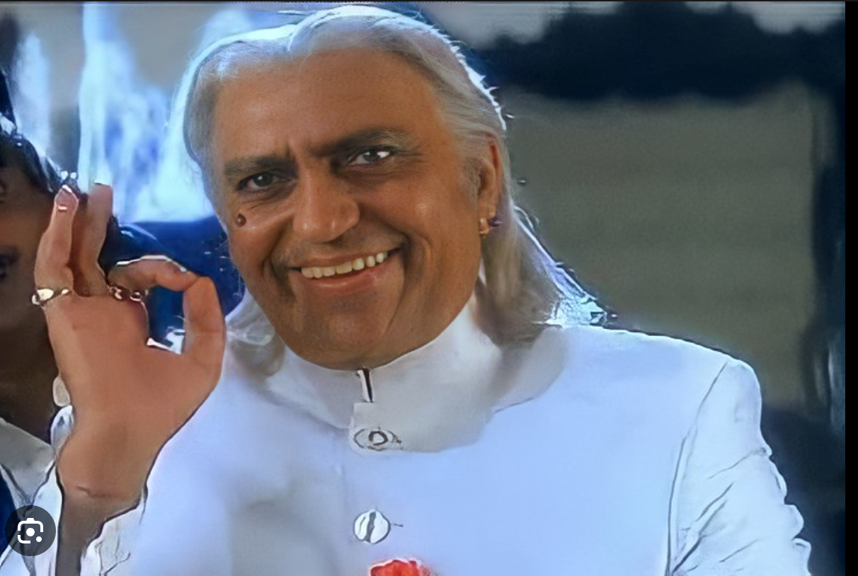
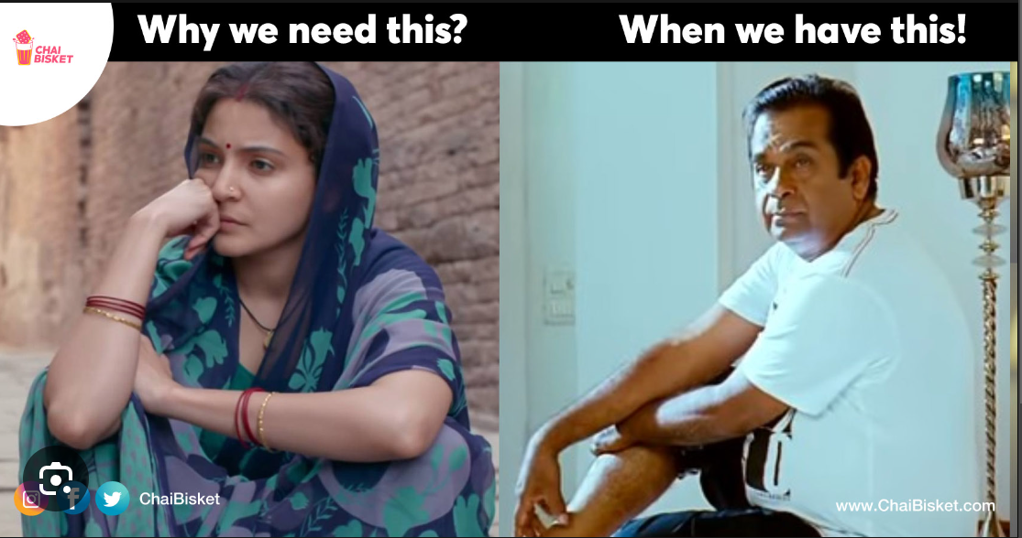
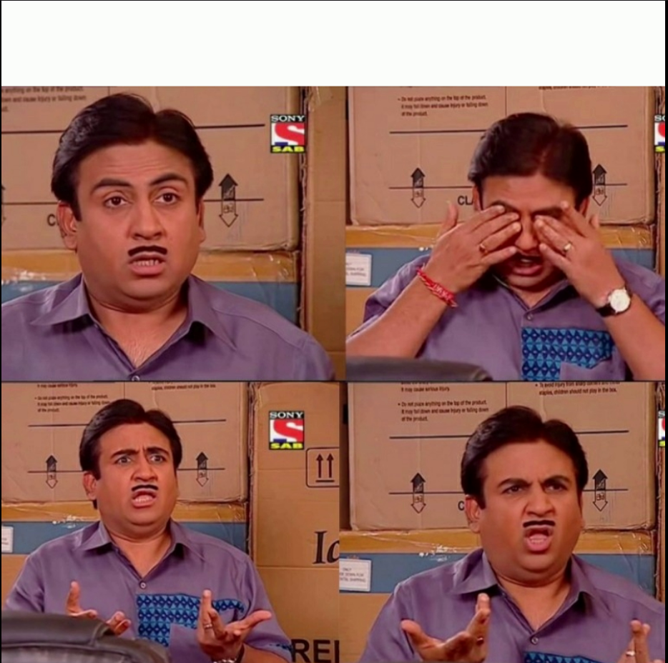
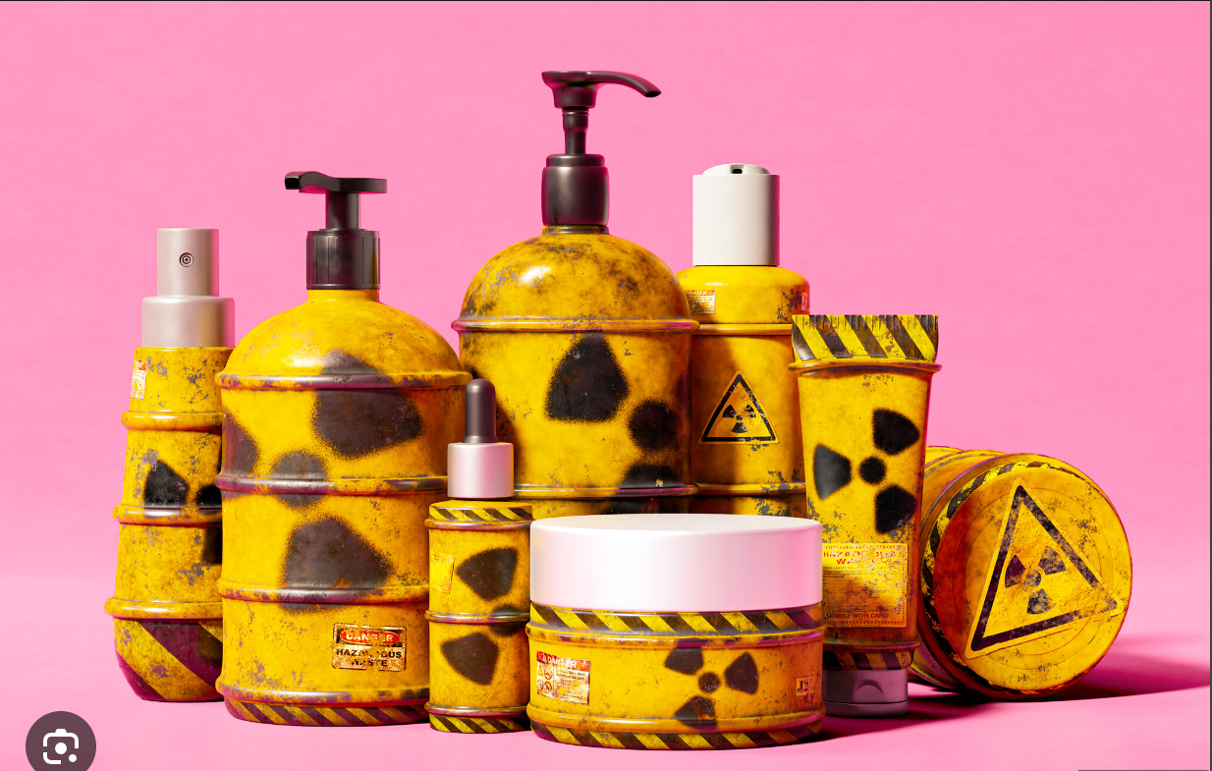
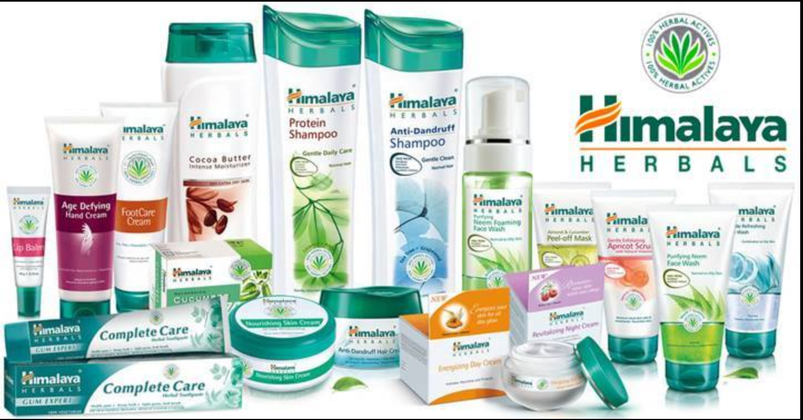
Format 3: Creative.
Aim: Brand awareness and reach.
Date: August 15th
Idea: To create some memes so as to attract young consumers and create health awareness among them.
When you see someone buy an healthcare product without checking if the ingredients are safe or not.
Customer reviews after using Himalaya Herbals Neem FaceWash.

Slide 33
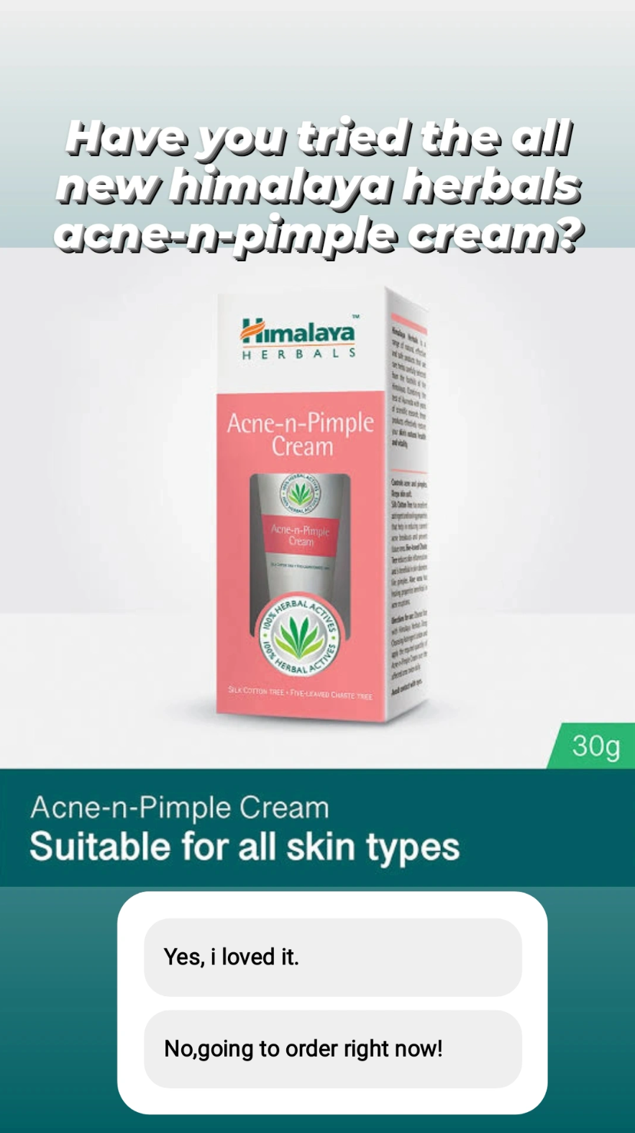
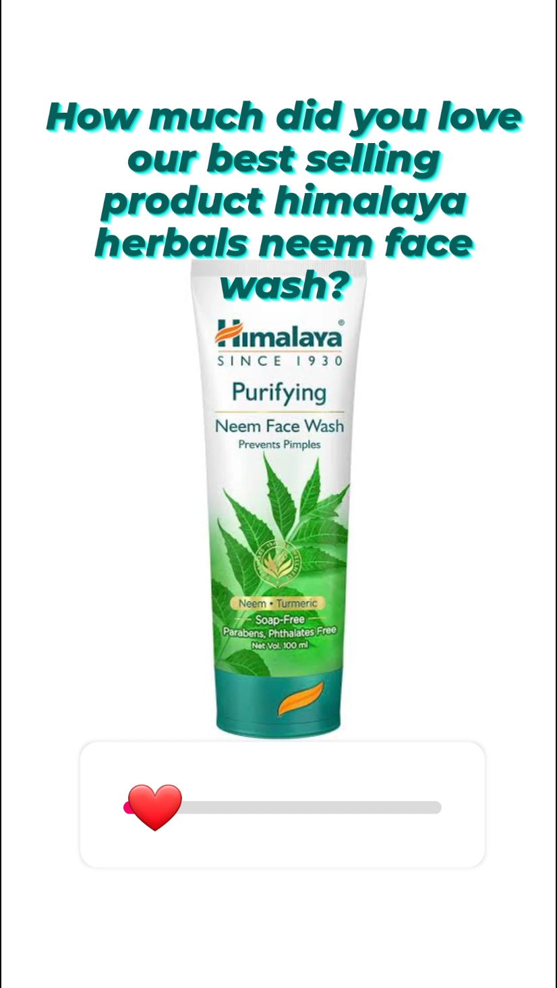
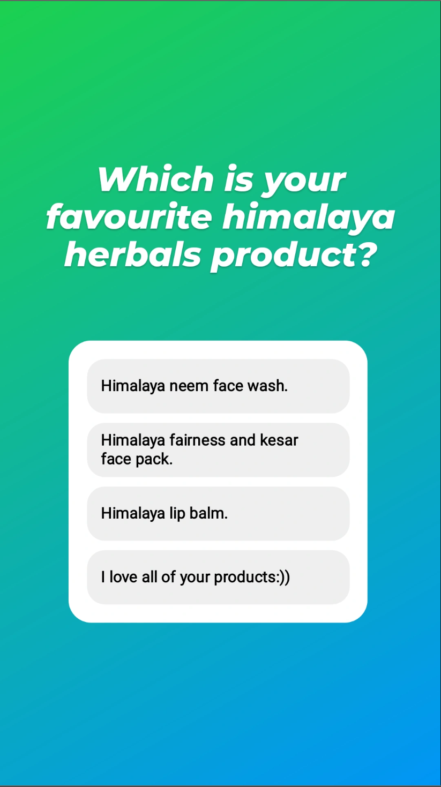
Part 4: Content Creation and Curation (Post creations, Designs/Video Editing, Ad Campaigns over Social Media and Email Ideation and Creation)
Instagram Story

Slide 34
Part 4: Content Creation and Curation (Post creations, Designs/Video Editing, Ad Campaigns over Social Media and Email Ideation and Creation)
Designs/Video Editing
Design Tools Familiarization (use Canva for creating visually appealing graphics)
Video Creation: Utilize VN or any video editor of your choice to create videos related to the chosen topic.

Slide 35
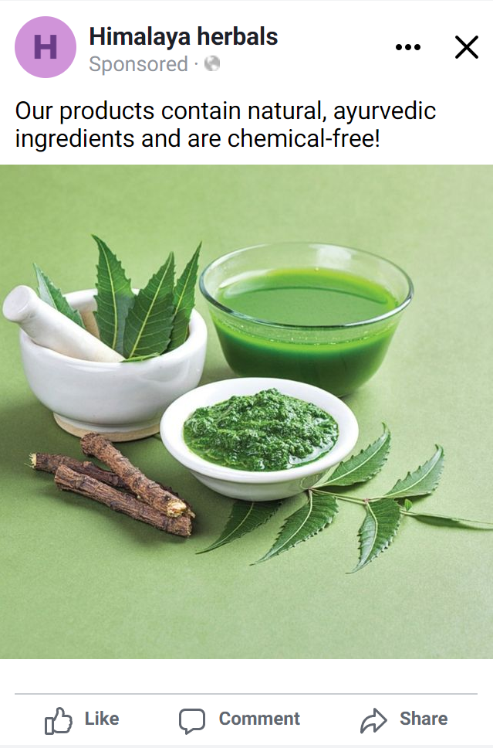
Part 4: Content Creation and Curation (Post creations, Designs/Video Editing, Ad Campaigns over Social Media and Email Ideation and Creation)
Social Media Ad Campaigns
Advertising Goal: To Increase Brand Awareness.
Target Audience:
15-70yrs old.
All genders.
Health and wellness enthusiasts.
Ad creation: letting our target audience know that our products are healthy and chemical-free.
Relevant CTA: to motivate the audience to check out our products.

Slide 36
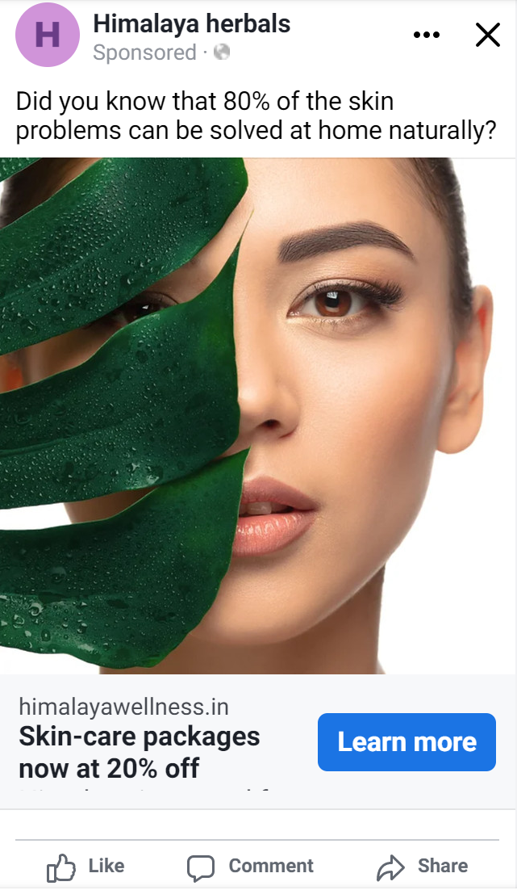
Advertising Goal: To Generate Website Traffic.
Target Audience:
15-70yrs old.
All genders.
Health and wellness enthusiasts.
Ad creation: creating skin care awareness among our target audience.
Relevant CTA: to generate a direct response from target audience by providing discount.

Slide 37
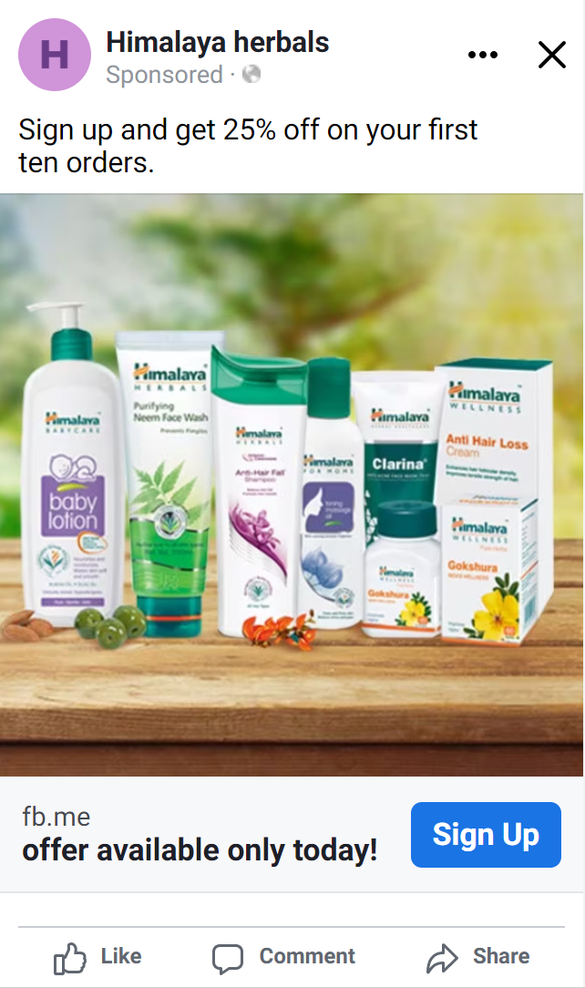
Advertising Goal: To Generate Leads.
Target Audience:
15-70yrs old.
All genders.
Health and wellness enthusiasts.
Ad creation: showcasing our products.
Relevant CTA: to sign up and acquire info.

Slide 38
Part 4: Content Creation and Curation (Post creations, Designs/Video Editing, Ad Campaigns over Social Media and Email Ideation and Creation)
Email Ad Campaigns
Ad Campaigns for email marketing:
Come up with 2 email ad campaigns with the mentioned goals: brand awareness & generating leads

Slide 39
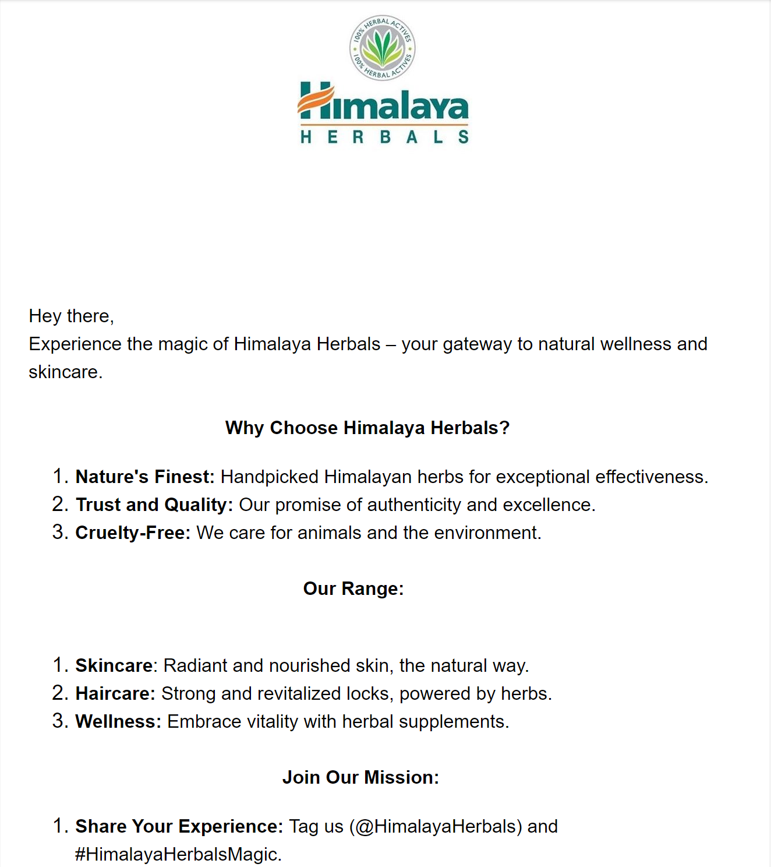
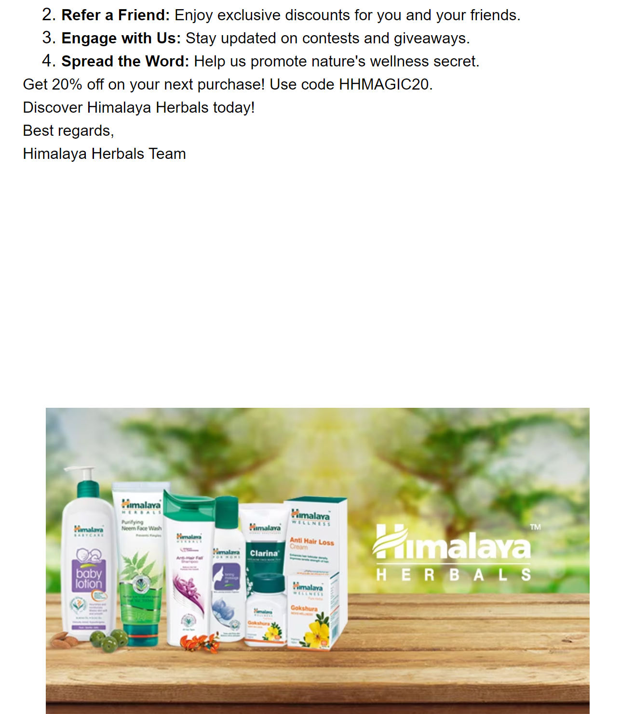
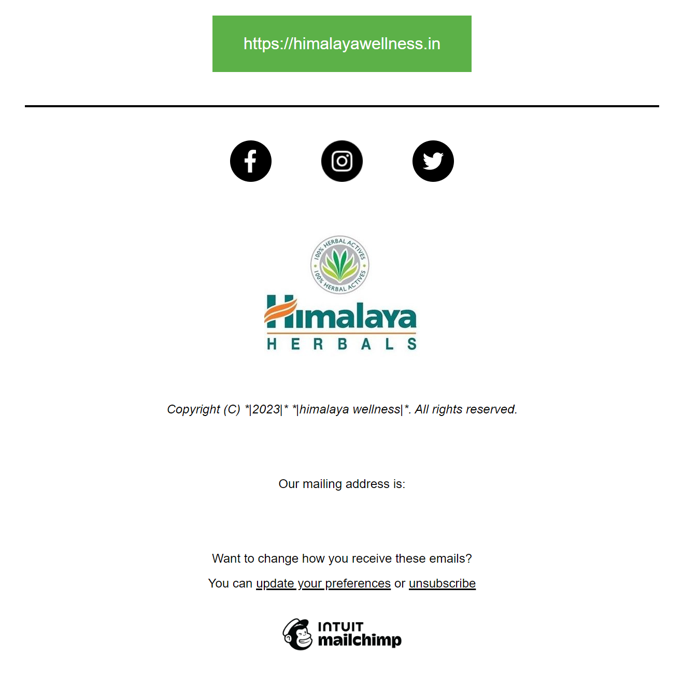
Email Ad Campaign 1 - Brand Awareness

Slide 40
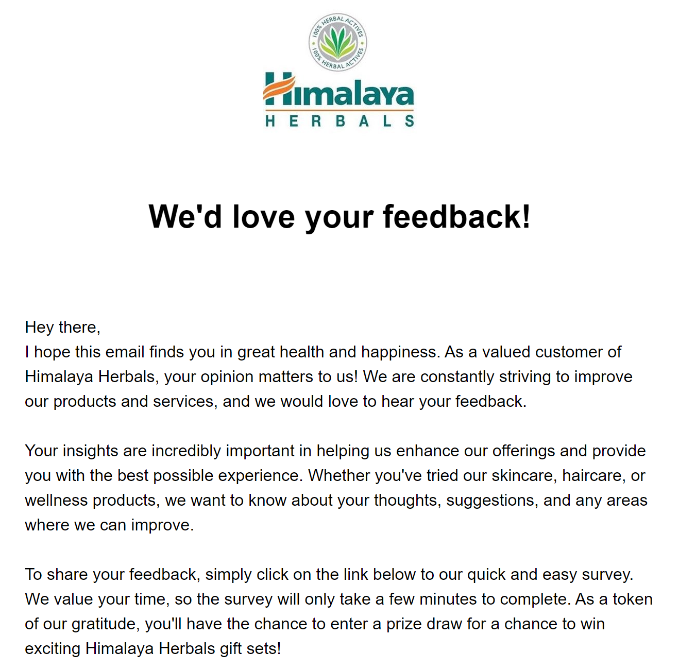
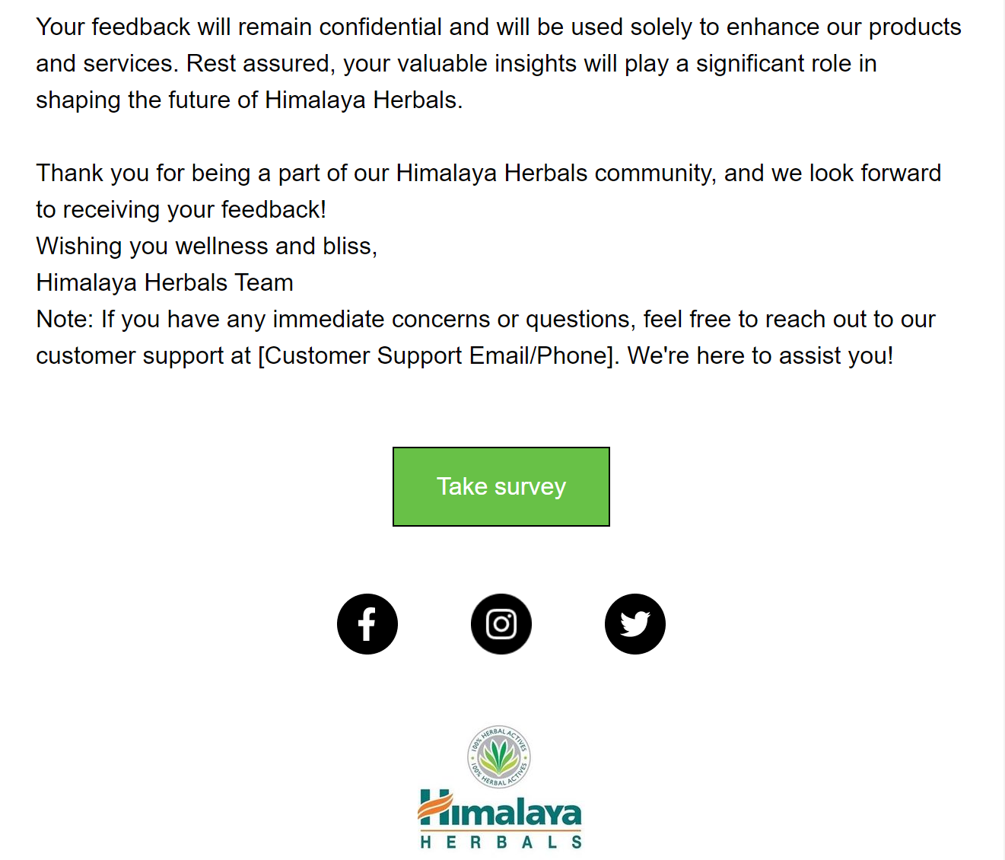
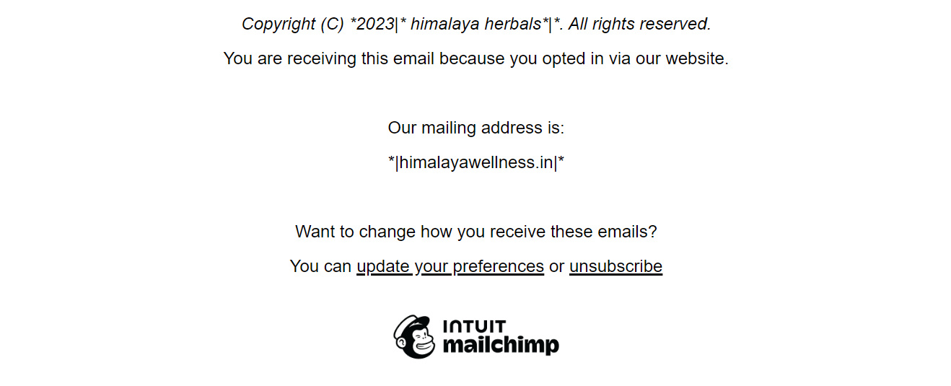
Email Ad Campaign 2 - Lead Generation

Slide 41
Part 4: Content Creation and Curation (Post creations, Designs/Video
Editing, Ad Campaigns over Social Media and Email Ideation and Creation)
Reflect on the content creation and curation process, discussing the challenges faced and lessons learned.
Content Creation And Curation Process:
The content creation and curation process has been challenging, fun and creative. For Instagram stories we created an Instagram account for Himalaya herbals then made three different types of stories to generate engagement from the audience. For the Instagram reel, we created a canva account, chose a video template and then edited the template with the brand colours, content etc.For facebook we created a business manager account and then an ad manager account and then it was relatively easy choosing who the target audience, template etc. As for emails, we created a mailchimp account, chose a template for the required marketing goal and manually typed the content.
Challenges encountered:
Understanding the brand and target audience.
Creating engaging and informative content.
Promoting a balanced message.
Building an engaging community.
Lessons learnt:
Investing time in understanding the brand and target audience at the initial stage can make the rest of the process effective.
Offering valuable tips and insights without making health claims can enhance audience trust.
Providing evidence-based information to support product claims can enhance credibility.

